Slide 1

Predictors OF Diabetes
By Karl Jones

Slide 2
Why should we care?
Estimates in 2018 were 34.2 million people in the U.S. had diabetes, that’s 10.5% of our population
Diabetes is growing in the U.S. current estimates are at 37.3 million, 28.7 million diagnosed and 8.5 million undiagnosed
An estimated 96 million people in the U.S. have prediabetes, that’s 38% of the U.S. population
Diabetes is the 8th leading cause of death in the U.S.
$1 out of every $4 in US health care costs is spent on caring for people with diabetes

Slide 3
Where is the Data From?
ACS Survey
CDC
County Health Rankings

Slide 4
Data Cleaning and Merging
ACS
Re-Used Prof. Yu’s code to get ACS data by county
CDC
Downloaded diagnosed diabetes incidence and mortality rates by county
County Health Rankings
Downloaded data on possible independent variables by county
I then cleaned up missing values and variable names after merging the data frames by county fips code

Slide 5

Let’s Visualize the Data

Slide 6
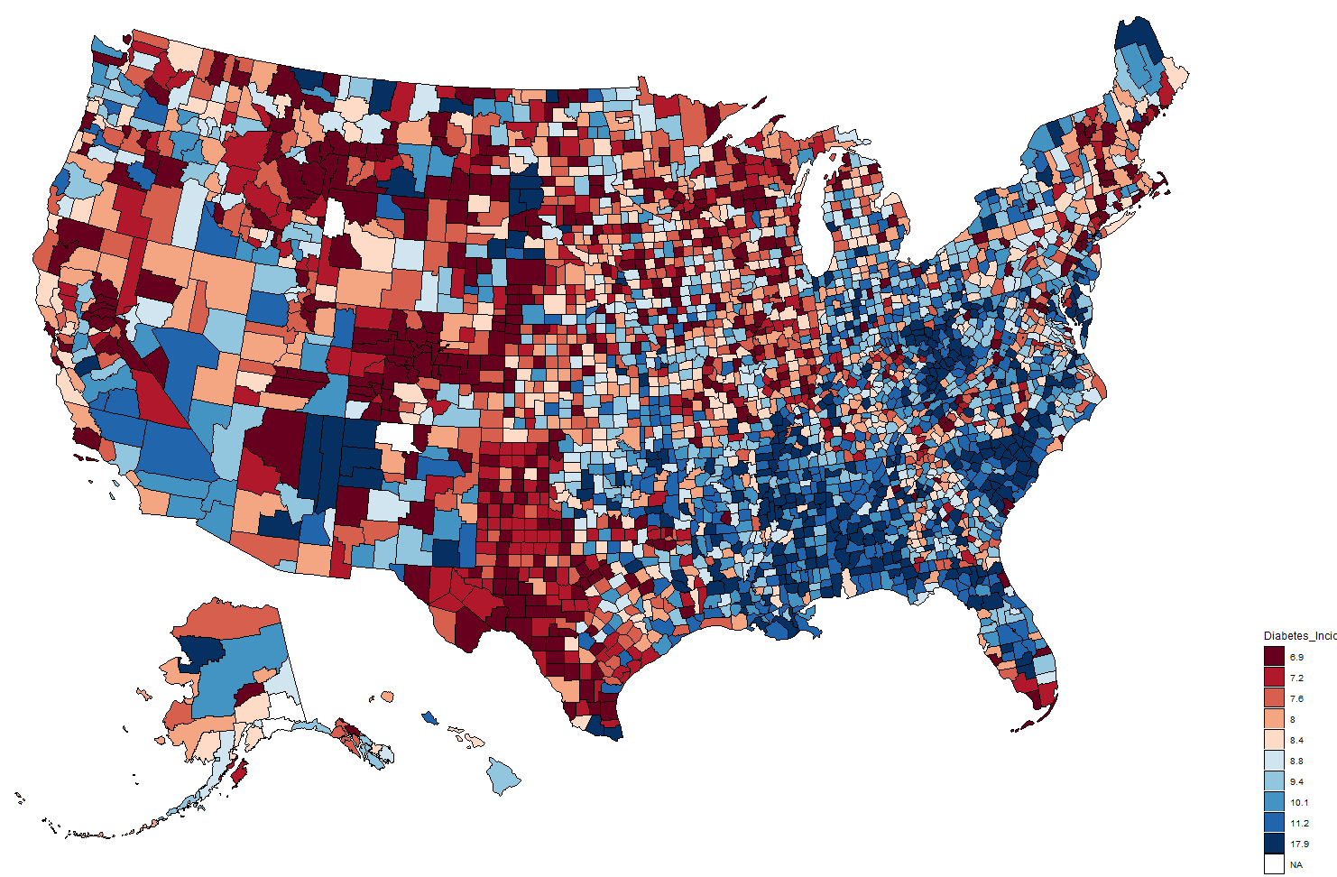
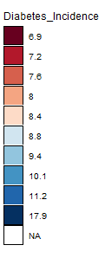
Map of Diabetes Incidence Rate By County

Slide 7
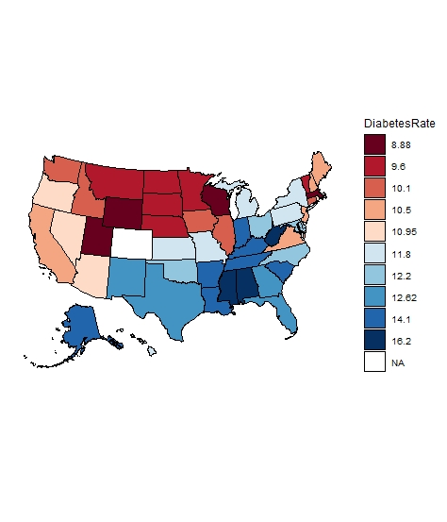
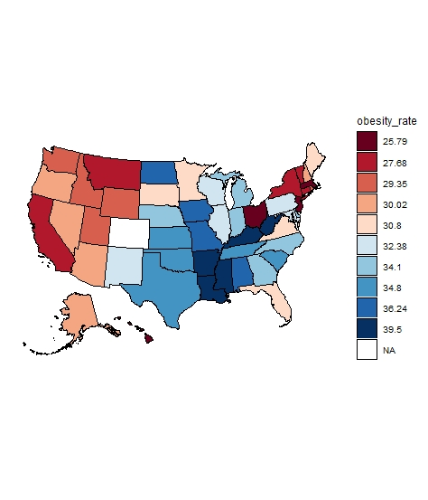
Diagnosed Diabetes And Obesity Rate By State
Map of Diabetes and Obesity rate are similar indicating obesity rate is likely a very significant factor for diabetes rate
Diabetes and obesity rate seem to be especially high in the South and Mid-East of the country

Slide 8
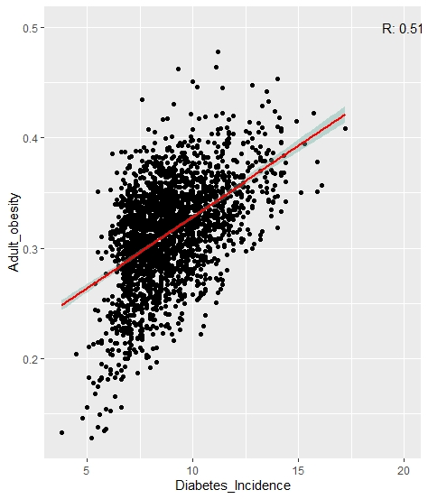
Diabetes Incidence rate and Obesity rate are indeed highly correlated

Slide 9
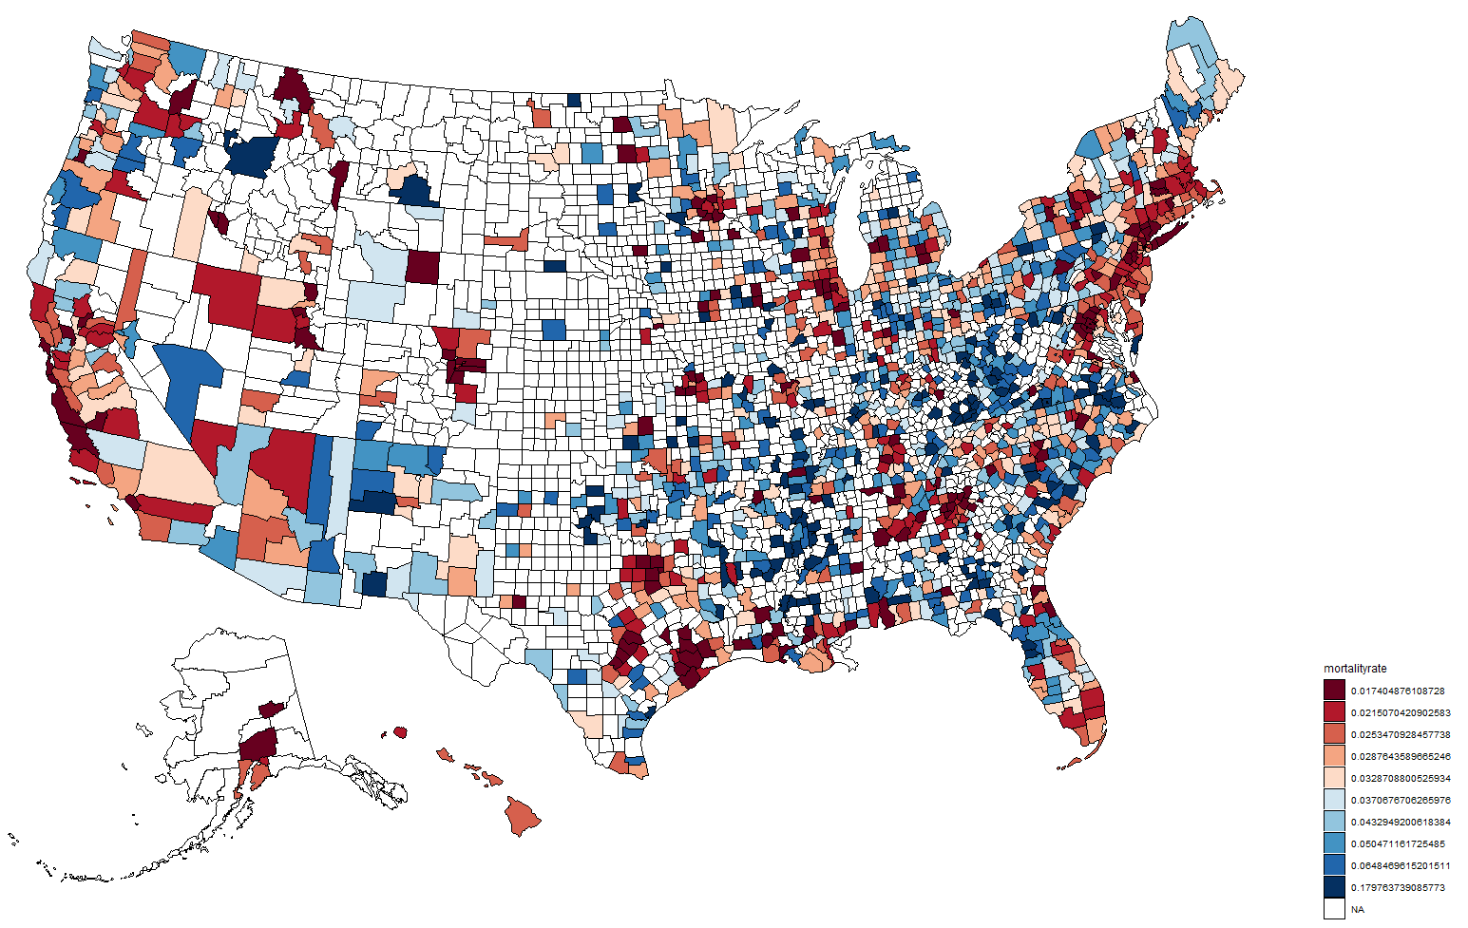
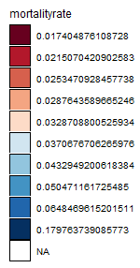
Mortality By County
Too Many NA’S To
Really Interpret

Slide 10
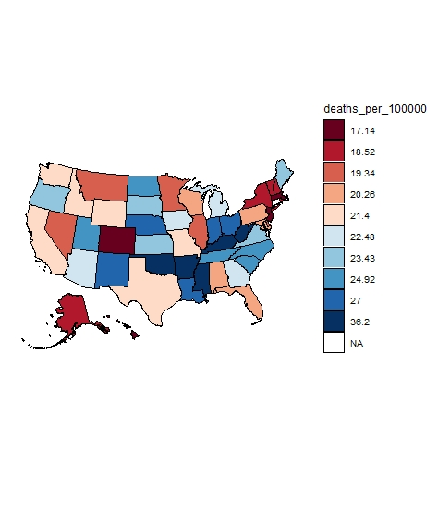
Mortality By State

Slide 11
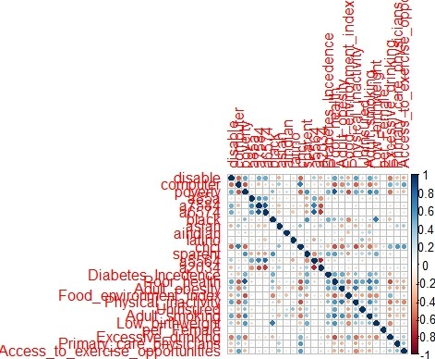
Correlation Plot Of Independent Variables

Slide 12
Machine Learning Models in R

Slide 13
Machine Learning Models
For Dependent Variable As Diagnosed Diabetes Incidence Rate
25 Numeric Independent Variables, 1 Factor Variable
2410 Observations Train/Test Split=75/25
Models will be evaluated on test RMSE(Root Mean Square Error)
Linear Regression with three different models
Stepwise AIC using direction backwards

Slide 14
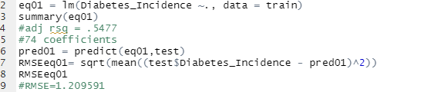
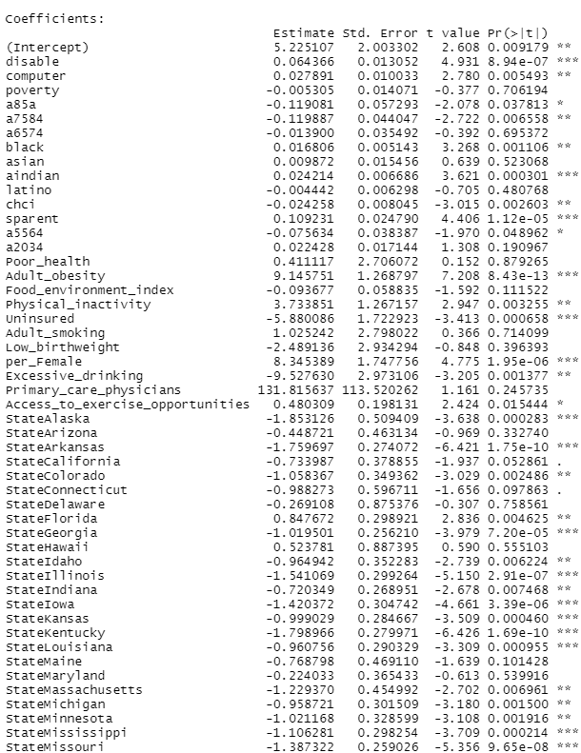
Eq01-All variables
Positive and significant:
Disable
Computer
Black
American Indian
Florida
South Carolina
Obesity
Physical Inactivity
Single Parent
Percent Female
Negative and significant:
Age 75-84
CHCI
Alaska
Arkansas
Colorado
Georgia
Idaho
Illinois
Iowa
Kansas
Kentucky
Louisiana
Mississippi
North Carolina
Oklahoma
South Dakota
Tennessee
Texas
Utah
Uninsured
Excessive Drinking

Slide 15
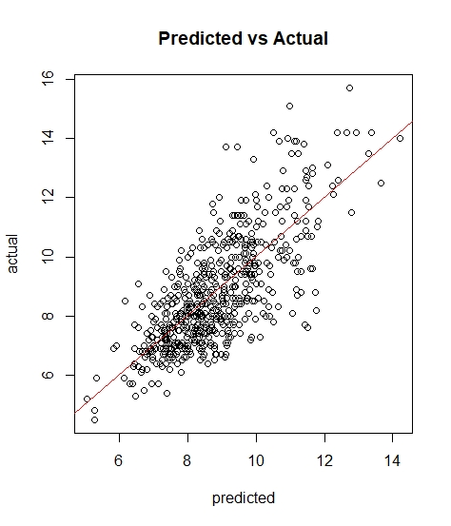
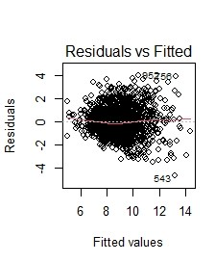
Eq01

Slide 16
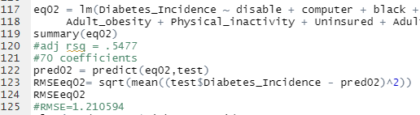
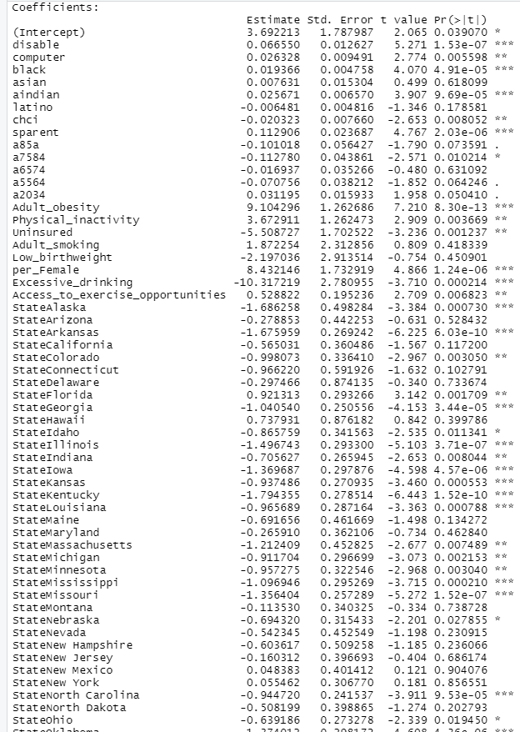
Eq02-Took out Some Insignificant Variables
Positive and significant:
Disable
Computer
Black
American Indian
Florida
South Carolina
Obesity
Physical Inactivity
Single Parent
Percent Female
Negative and significant:
CHCI
Alaska
Arkansas
Colorado
Georgia
Idaho
Illinois
Iowa
Kansas
Kentucky
Louisiana
Mississippi
North Carolina
Oklahoma
South Dakota
Tennessee
Texas
Utah
Uninsured
Excessive Drinking

Slide 17
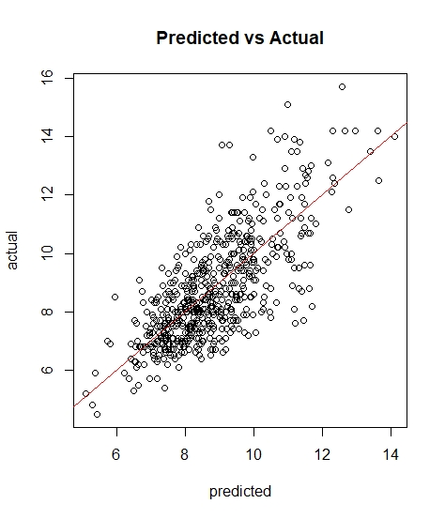
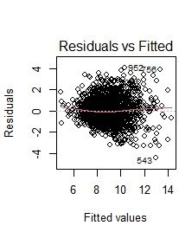
Eq02

Slide 18
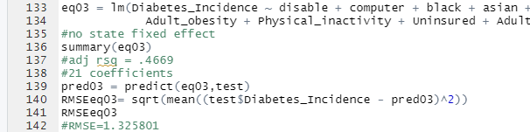
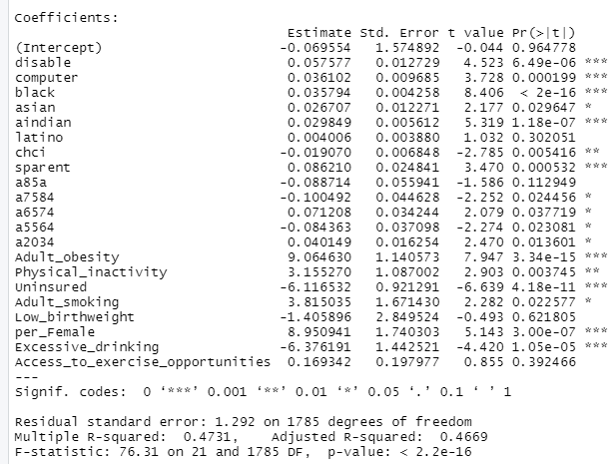
Eq03-Eq02 With No State Fixed Effect
Positive and significant:
Disable
Computer
Black
American Indian
Obesity
Physical Inactivity
Single Parent
Percent Female
Negative and significant:
CHCI
Uninsured
Excessive Drinking

Slide 19
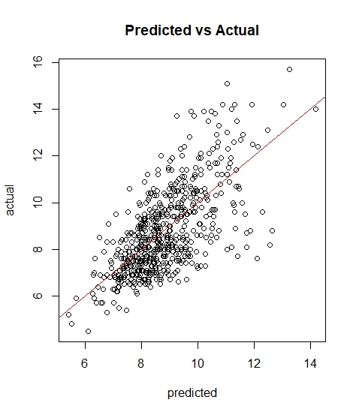
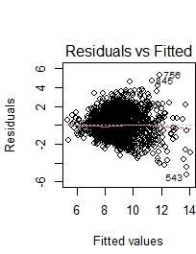
Eq03

Slide 20
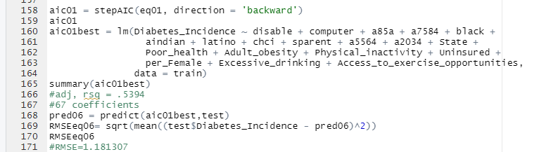
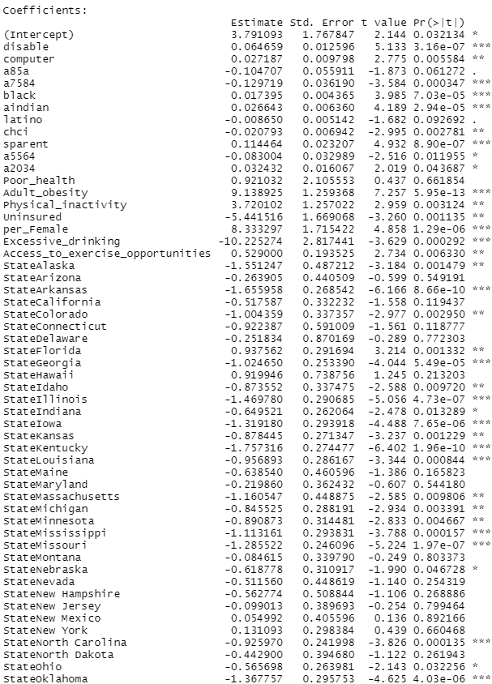
Aic01-Stepwise AIC Model
Positive and significant:
Disable
Computer
Black
American Indian
Florida
South Carolina
Obesity
Physical Inactivity
Single Parent
Percent Female
Negative and significant:
CHCI
Age 75-84
Alaska
Arkansas
Colorado
Georgia
Idaho
Illinois
Iowa
Kansas
Kentucky
Louisiana
Mississippi
North Carolina
Oklahoma
South Dakota
Tennessee
Texas
Utah
Uninsured
Excessive Drinking

Slide 21
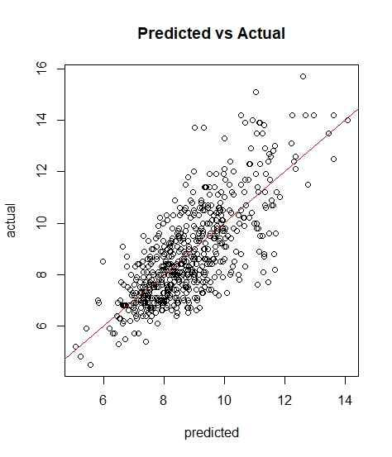
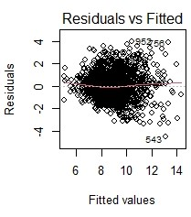
AIC01

Slide 22
Machine Learning Models
For Dependent Variable As Diabetes Mortality Rate
25 Numeric Independent Variables, 1 Factor Variable
1433 Observations Train/Test Split=75/25
Models will be evaluated on test RMSE(Root Mean Square Error)
Linear Regression with three different models
Stepwise AIC using direction backwards

Slide 23
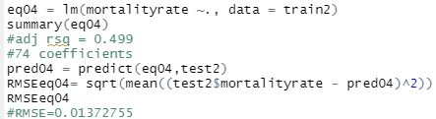
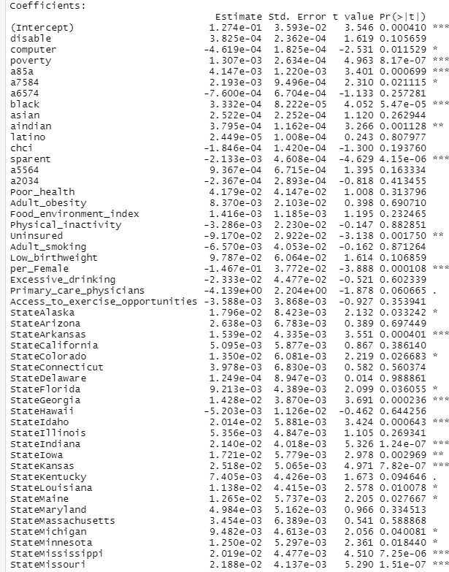
Eq04-All variables
Positive and significant:
Poverty
Age 85+
Black
Arkansas
Indiana
Iowa
Kansas
Mississippi
Missouri
Nebraska
South Dakota
Virginia
Oklahoma
Negative and significant:
Computer
Single Parent
Uninsured
Percent Female

Slide 24
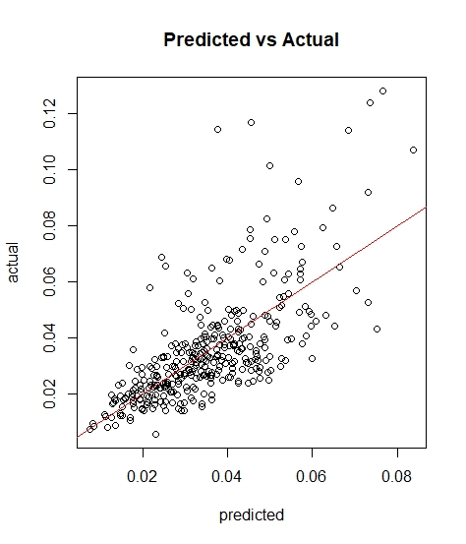
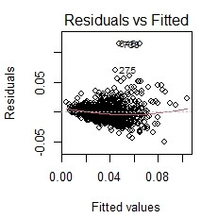
Eq04

Slide 25
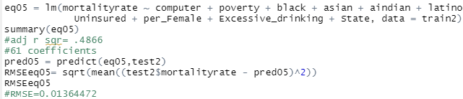
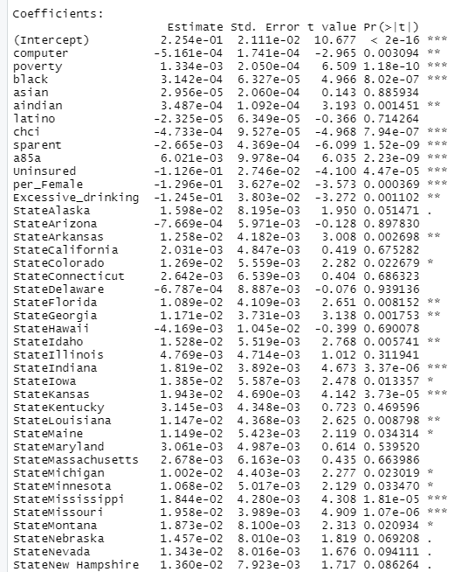
Eq05-Eq04 Without Some Insignificant Variables
Positive and significant:
Black
Poverty
Age 85+
Indiana
Kansas
Mississippi
Missouri
South Dakota
Virginia
Texas
Negative and significant:
Computer
CHCI
Single Parent
Uninsured
Excessive Drinking

Slide 26
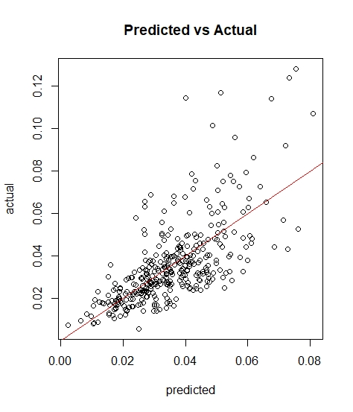
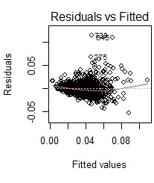
Eq05

Slide 27
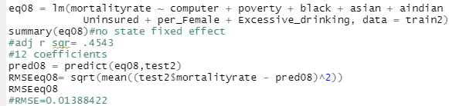
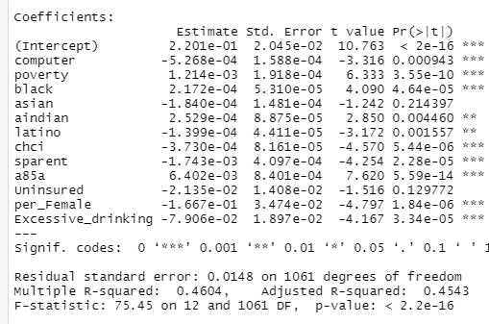
Eq08-Eq05 Without State Fixed Effect
Positive and significant:
Black
American Indian
Poverty
Age 85+
Negative and significant:
Computer
CHCI
Single Parent
Excessive Drinking
Percent Female
Latino

Slide 28
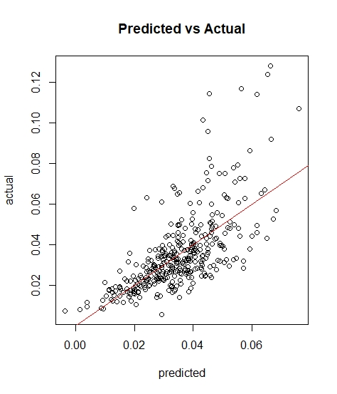
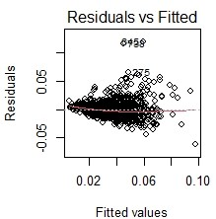
Eq08

Slide 29
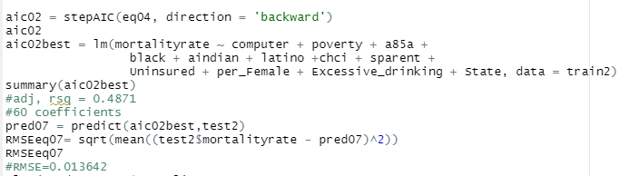
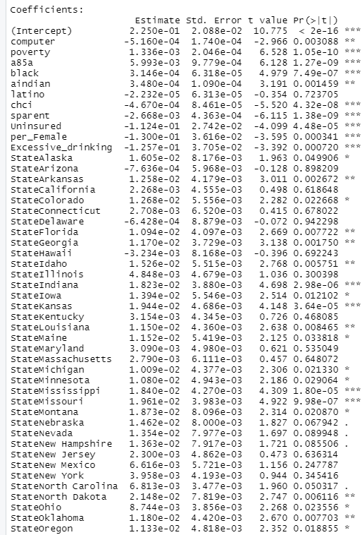
AIC02-Stepwise AIC Model
Positive and significant:
Black
Poverty
Ages 85+
American Indian
Indiana
Iowa
Kansas
Mississippi
Missouri
Ohio
Oklahoma
South Dakota
Texas
Virginia
Negative and significant:
Computer
CHCI
Single Parent
Uninsured
Excessive Drinking
Percent Female

Slide 30
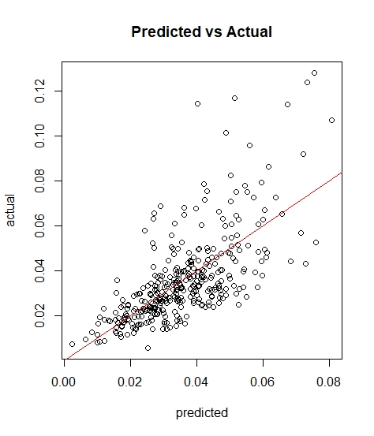
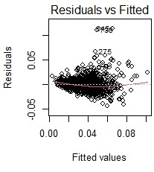
AIC02

Slide 31
Machine Learning Models in Python

Slide 32
Machine Learning Models
For Dependent Variable As Diagnosed Diabetes Incidence Rate
25 Numeric Independent Variables, 1 Factor Variable
2410 Observations Train/Test Split=75/25
Models will be evaluated on test RMSE(Root Mean Square Error)
Random Forest Model(n_estimators=100, random_state=1,min_samples_split = 15, max_depth=25)
Xgboost Model(max_depth=5, learning_rate=0.08, n_estimators=300 )

Slide 33
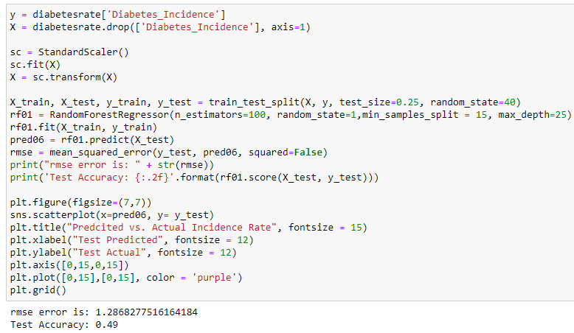
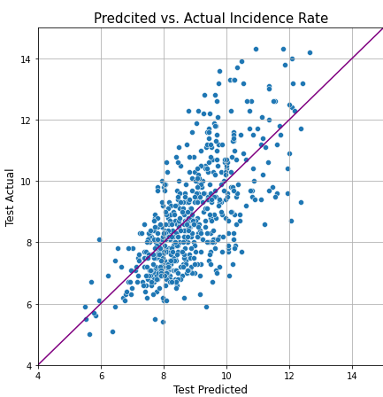
Random Forest Model

Slide 34
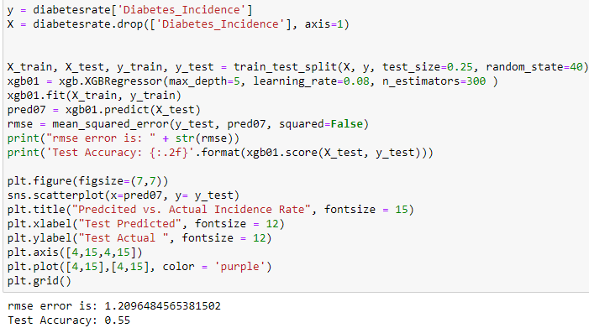
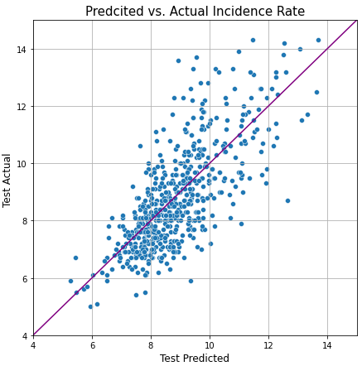
Xgboost Model

Slide 35
Machine Learning Models
For Dependent Variable As Diabetes Mortality Rate
25 Numeric Independent Variables, 1 Factor Variable
1433 Observations Train/Test Split=75/25
Models will be evaluated on test RMSE(Root Mean Square Error)
Random Forest Model(n_estimators=100, random_state=1,min_samples_split = 10, max_depth=10)
Xgboost Model(max_depth=5, learning_rate=0.08, n_estimators=100 )

Slide 36
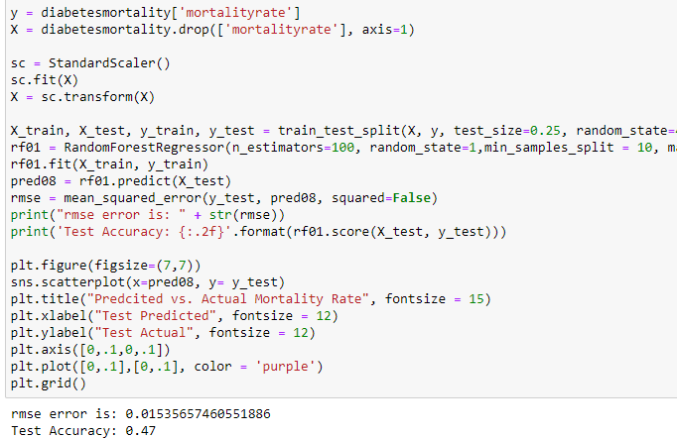
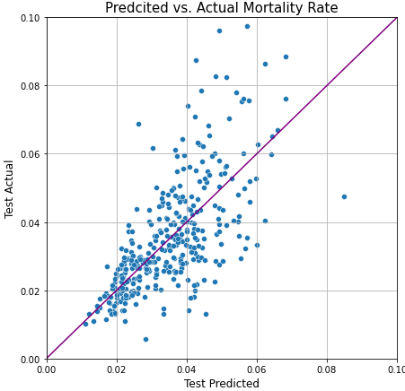
Random Forest Model

Slide 37
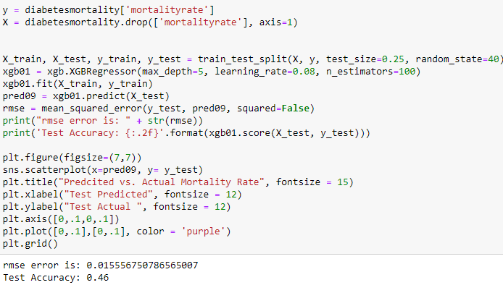
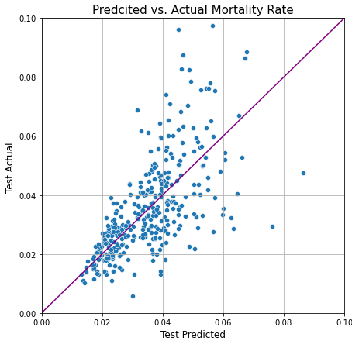
Xgboost Model

Slide 38
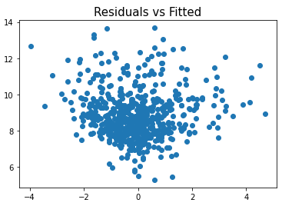

Incidence Rate Residual Plots
Random Forest
Xgboost

Slide 39


Mortality Rate Residual Plots
Random Forest
Xgboost

Slide 40
Evaluation Of Machine Learning Models

Slide 41
Dependent Variable- Incidence Rate
Eq01-RMSE=1.209591
Eq02-RMSE=1.210594
Eq03-RMSE=1.325801
AIC01-RMSE=1.181307
RF-RMSE=1.286827
XGB-RMSE=1.209648
So, the best prediction model in terms of Root Mean Square Error is AIC01, the Stepwise AIC model.

Slide 42
Dependent Variable- Mortality Rate
Eq04-RMSE=.01372755
Eq05-RMSE=.01364472
Eq08-RMSE=.01388422
AIC02-RMSE=.013642
RF-RMSE=.015356
XGB-RMSE=.015556
So, the best prediction model in terms of Root Mean Square Error is again the Stepwise AIC model, however eq05 was very close only about .000002 higher error, so either model could be used

Slide 43
Takeaways and Conclusions

Slide 44
Most Import Predictors For Diabetes Incidence Rate
Models Explained Around 46-55% of The Variance
Positive Correlation
Obesity
Physical Inactivity
Single Parent
Percent Female
Disable
Computer
Black
American Indian
Negative Correlation
CHCI
Uninsured
Excessive Drinking

Slide 45
Most Import Predictors For Diabetes Mortality Rate
Models Explained Around 45-50% of The Variance
Positive Correlation
Poverty
Age 85+
Age 75-84
Black
American Indian
Negative Correlation
Computer
CHCI
Single Parent
Uninsured
Percent Female

Slide 46
State Diagnosed Diabetes Incidence
State Diabetes Mortality
Positive Correlation
Arkansas
Indiana
Iowa
Kansas
Mississippi
Missouri
Nebraska
South Dakota
Virginia
Oklahoma
Ohio
Texas
Negative Correlation
Alaska
Arkansas
Colorado
Georgia
Idaho
Illinois
Iowa
Kansas
Kentucky
Louisiana
Mississippi
North Carolina
Oklahoma
South Dakota
Tennessee
Texas
Utah
Poor Health Care?
Unresponsible Population in these States?

Slide 47
Finished

